Slide 1
Team 11 Ice Cave Crystals
Nathan V, Max B, Josh A, Harry J-R, Zhenhua B

Slide 2
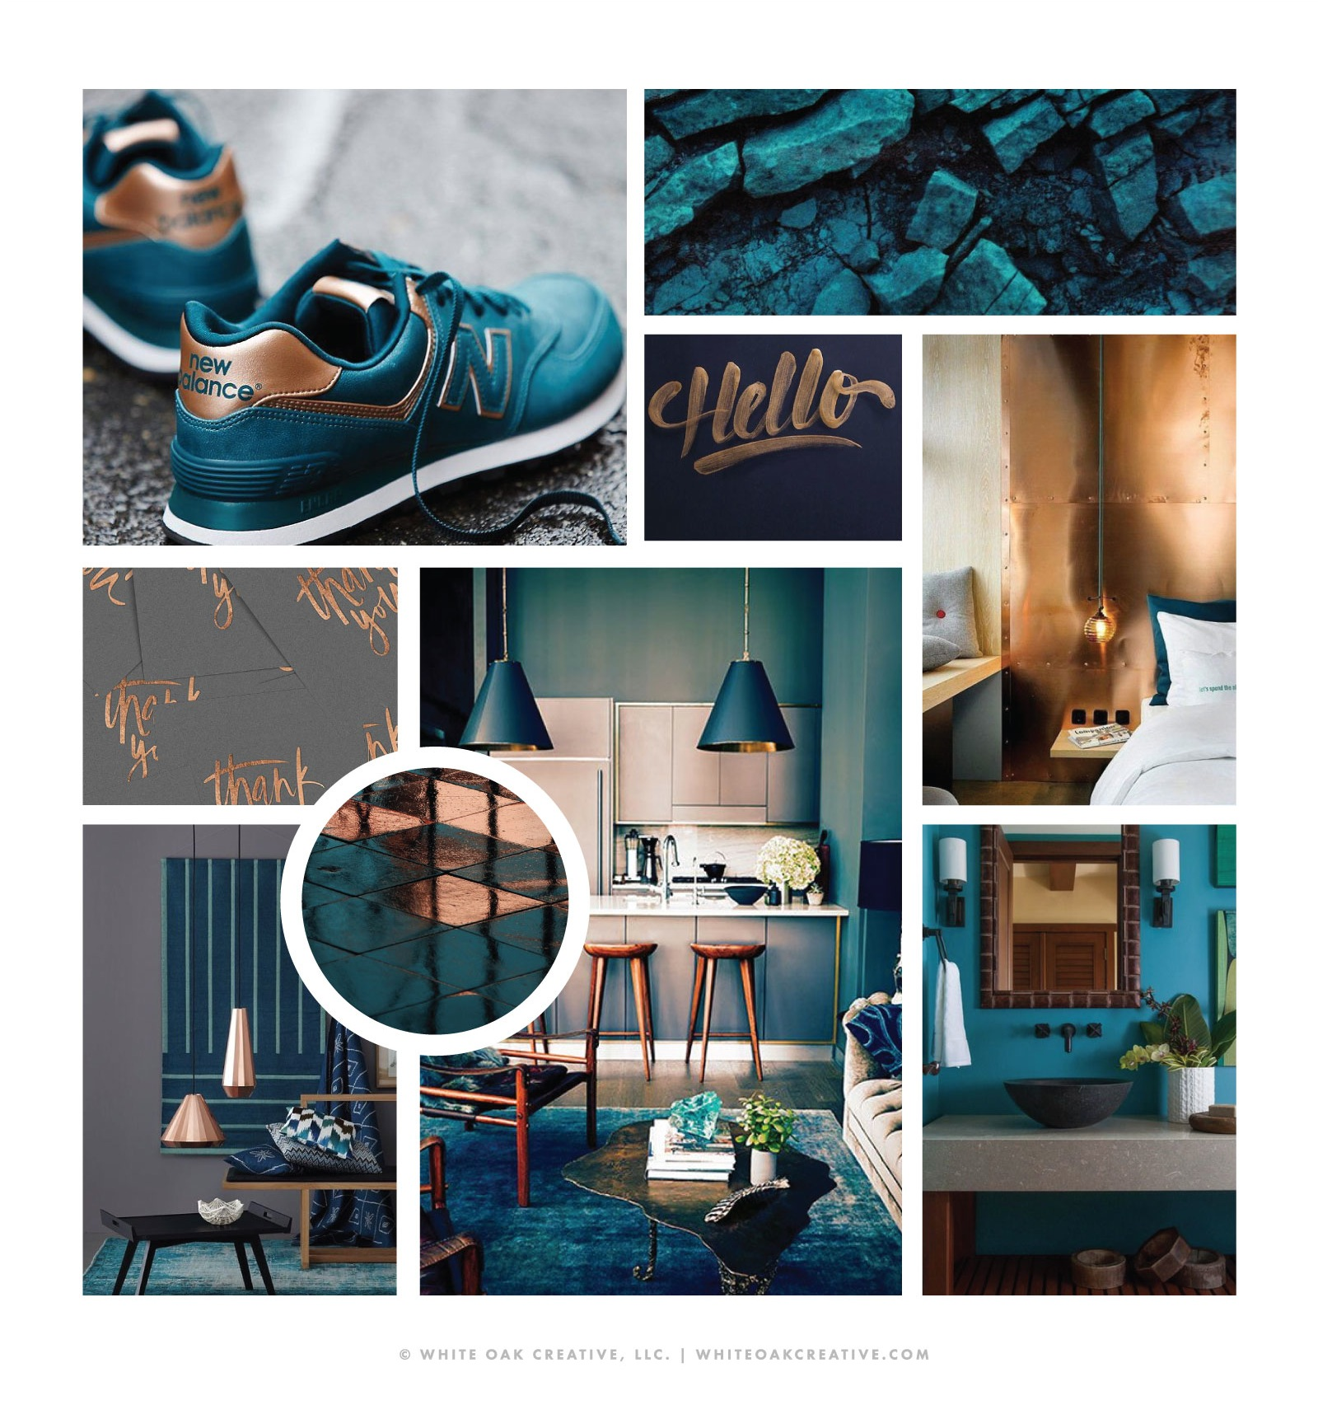
Research board

Slide 3
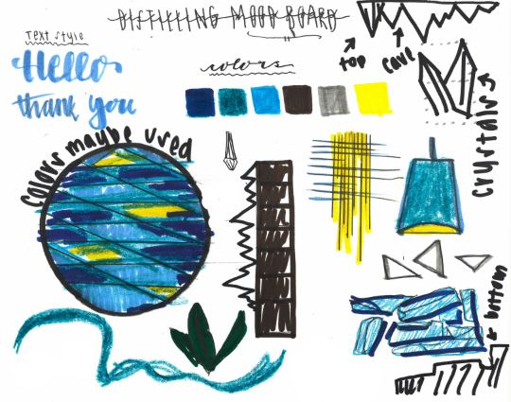
Distillation

Slide 4
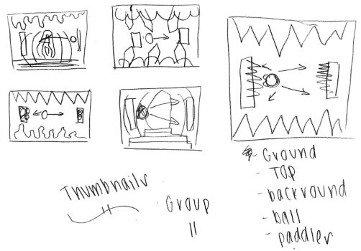
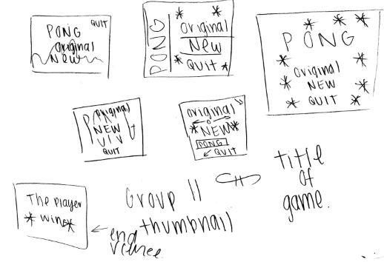
Thumbnails

Slide 5
Final art

Slide 6
Screenshot of the game

